Slide 1
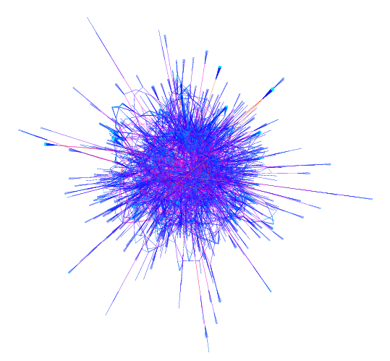
Negative curvature in real-world networks
Heather M. Guarnera
The College of Wooster

Slide 2
Why graph networks?

Slide 3
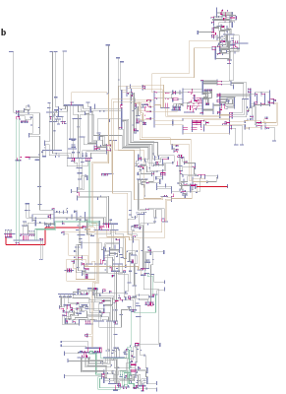
Graphs are everywhere
computer network
NYS Electric
Power Grid

Slide 4

Graphs are everywhere
Utility Patent network
1972-1999
(3 Million patents)

Slide 5
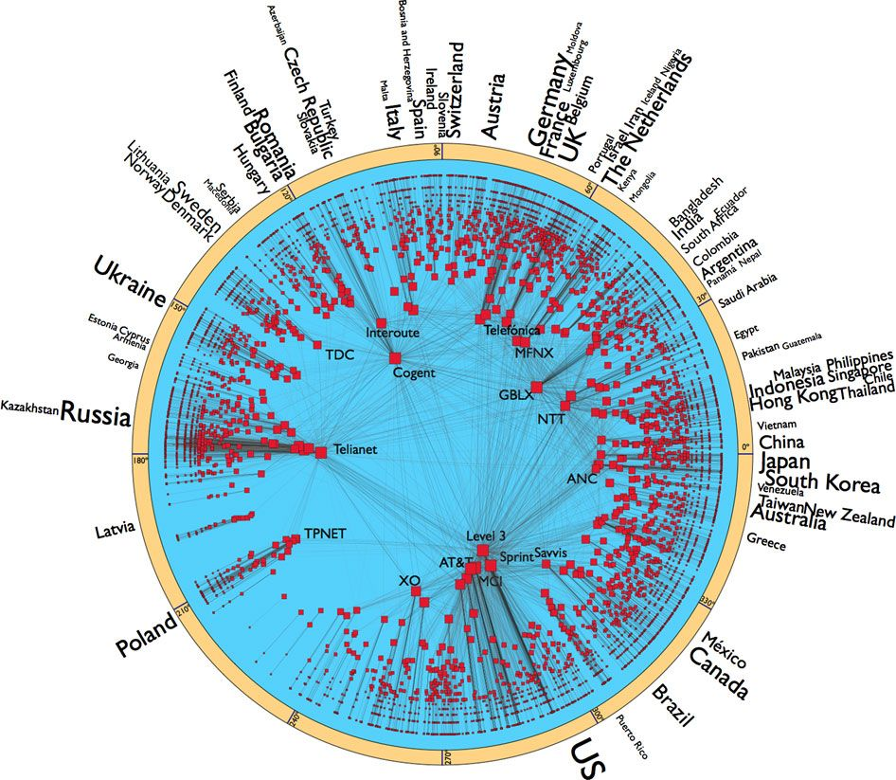
Graphs are everywhere
Internet (AS-level)
nodes n = 23,752 autonomous systems
edges m = 58,416 AS links
Notes:
AS-Level internet graph (AS is a collection of routers whose prefixes and routing policies are under common administrative control. This could be a network service provider, a large company, a university, a division of a company, or a group of companies. The AS represents a connected group of one or more blocks of IP addresses, called IP prefixes, that have been assigned to that organization and provides a single routing policy to systems outside the AS. Autonomous Systems create a two-level hierarchy for routing in the Internet)
* nodes = 23752 autonomous systems (AS)
* size is proportional to the logarithm of their degrees
* only AS with deg >3 is shown
* font size of countries proportional to logarithm of the number of ASs the country has
* only countries with more than 10 ASs are included
* edges = 58416 AS links
* data collected by the archipelago active measurement infrastructure developed by Cooperative Association for Internet Data Analysis
* hb(G) <= 2.5 (as measured from various DIMES and CAIDA data sets)

Slide 6
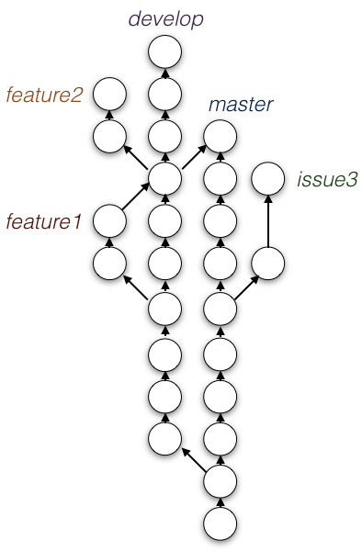

Graphs are everywhere

Slide 7
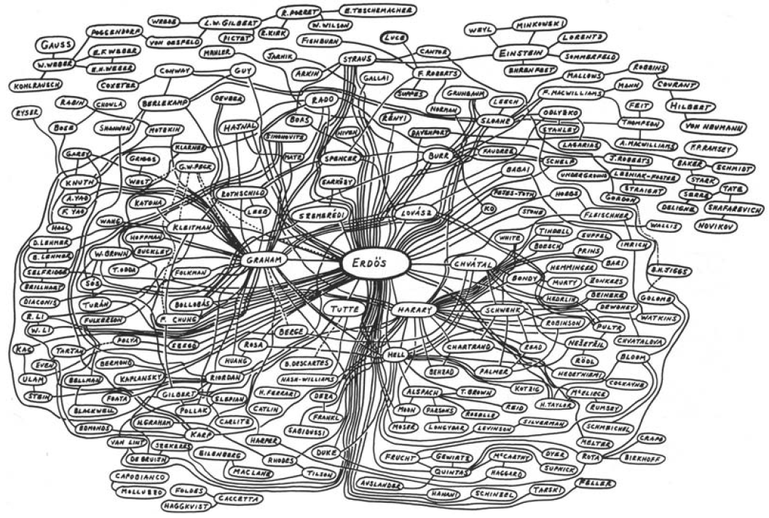
Graphs are everywhere

Slide 8
What is Fellow Travelers Phenomenon?

Slide 9
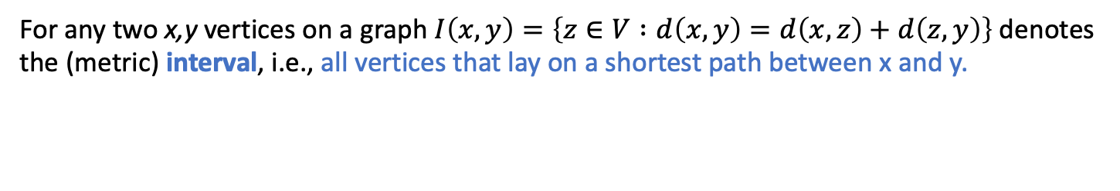
(Interval) Thinness of graphs
For any two x,y vertices on a graph $I\left(x,y\right)=\left\{z∈V :d\left(x,y\right)=d\left(x,z\right)+d\left(z,y\right)\right\}$denotes the (metric) interval, i.e., all vertices that lay on a shortest path between x and y.
x
y

Slide 10
(Interval) Thinness of graphs
For any two x,y vertices on a graph $I\left(x,y\right)=\left\{z∈V :d\left(x,y\right)=d\left(x,z\right)+d\left(z,y\right)\right\}$denotes the (metric) interval, i.e., all vertices that lay on a shortest path between x and y.
x
y

Slide 11
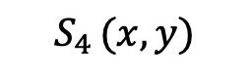
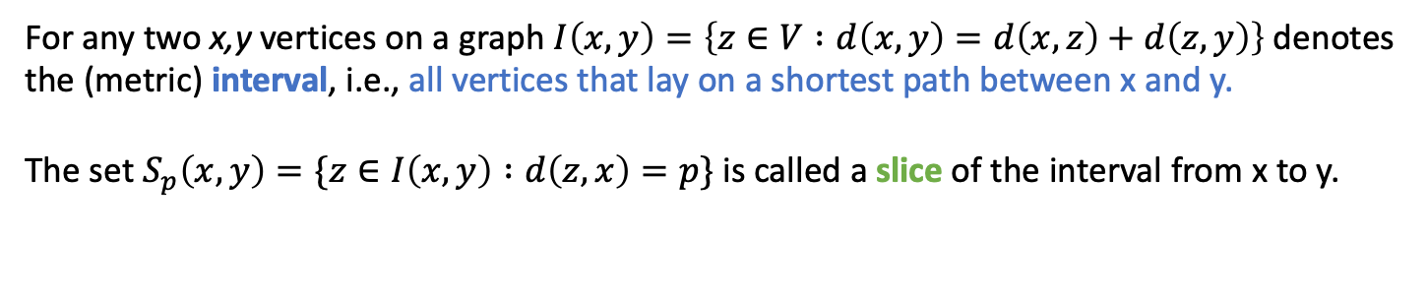
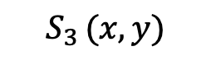
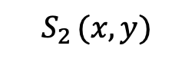
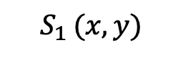
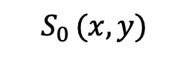
(Interval) Thinness of graphs
For any two x,y vertices on a graph $I\left(x,y\right)=\left\{z∈V :d\left(x,y\right)=d\left(x,z\right)+d\left(z,y\right)\right\}$denotes the (metric) interval, i.e., all vertices that lay on a shortest path between x and y.
The set $S_{p}\left(x,y\right)=\{z∈I\left(x,y\right) :d\left(z,x\right)=p\}$ is called a slice of the interval from x to y.
x
y
$$S_{0 }(x,y)$$
$$S_{4 }(x,y)$$
$$S_{1 }(x,y)$$
$$S_{3 }(x,y)$$
$$S_{2 }(x,y)$$

Slide 12
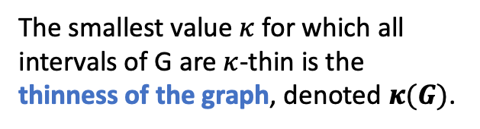
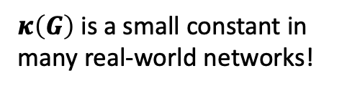

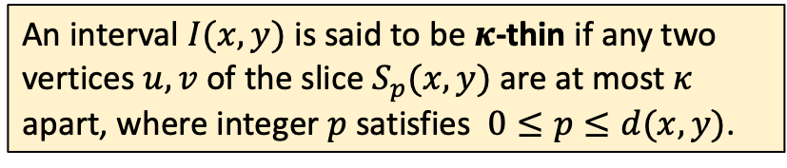
(Interval) Thinness of graphs
For any two x,y vertices on a graph $I\left(x,y\right)=\left\{z∈V :d\left(x,y\right)=d\left(x,z\right)+d\left(z,y\right)\right\}$denotes the (metric) interval, i.e., all vertices that lay on a shortest path between x and y.
The set $S_{p}\left(x,y\right)=\{z∈I\left(x,y\right) :d\left(z,x\right)=p\}$ is called a slice of the interval from x to y.
An interval $I(x,y)$ is said to be $κ$-thin if any two vertices $u,v$ of the slice $S_{p}(x,y)$ are at most $κ$ apart, where integer $p$ satisfies $0≤p≤d(x,y)$.
Ex: $I(x,y)$ is 2-thin.
x
y
The smallest value $κ$ for which all intervals of G are $κ$-thin is the thinness of the graph, denoted $κ(G)$.
$$S_{0 }(x,y)$$
$$S_{4 }(x,y)$$
$$S_{1 }(x,y)$$
$$S_{3 }(x,y)$$
$κ\left(G\right)$ is a small constant in many real-world networks!
$$S_{2 }(x,y)$$

Slide 13
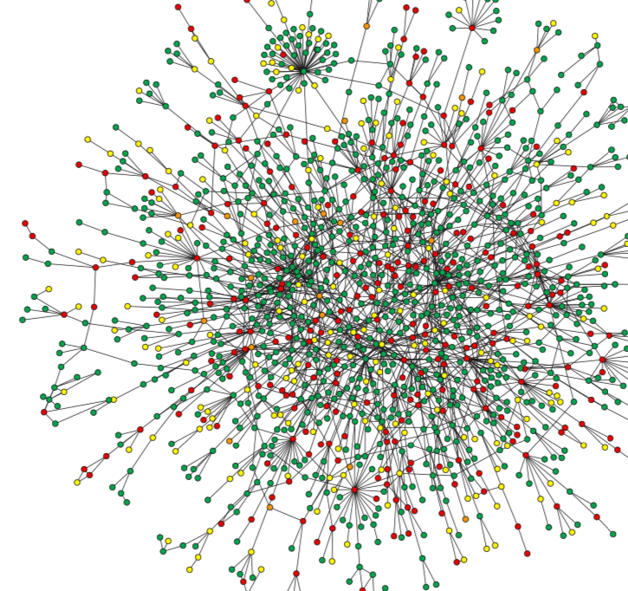
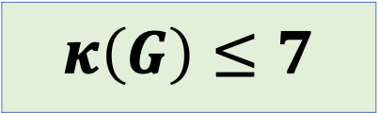
Ex: Protein Interaction Network
nodes n = 1,870 proteins
edges m = 2240 direct physical interactions between proteins
$$κ\left(G\right)≤7$$

Slide 14
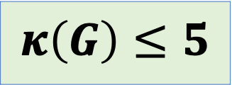
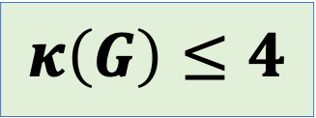
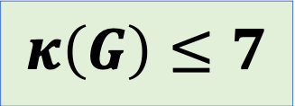
Ex: Other real-world networks with small thinness
Social networks (subset of Facebook)
nodes n = 293,501 users
edges m = 5,589,802 friendships between users
Web networks (from Google)
nodes n = 855,802 websites
edges m = 4,291,352 hyperlinks connecting sites
Peer-to-peer networks (Gnutella)
nodes n = 62,561 hosts
edges m = 147,878 connections between hosts
$$κ\left(G\right)≤7$$
$$κ\left(G\right)≤4$$
$$κ\left(G\right)≤5$$

Slide 15
Fellow travelers phenomenon is attributed to the negative curvature of the graph

Slide 16

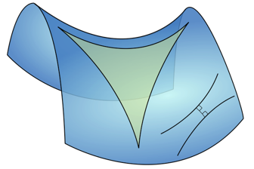
Geometric characteristics of real-world networks
Surge of recent empirical and theoretical work analyzes geometric characteristics
One important property: negative curvature
causes traffic between vertices to pass through a relatively small core of the network – as if the shortest paths between them were curved inwards
measured in many different (somewhat equivalent) ways
Zero Curvature
Negative Curvature
Notes:
In a metric space with zero curvature, such as the Euclidean space we all know and love, each angle of an equilateral triangle is exactly 60*
Instead, negative curvature in a metric space indicates that an equilateral triangle has angles less than 60*
* There are some metric spaces known to be hyperbolic, such as a Poincare disk (shown here),
* In a metric space or graph with negative curvature, we see this sort of bending property in shortest paths.
It’s been shown that hyperbolic graphs embed with better accuracy into a hyperbolic space than into a Euclidean space of comparable dimension.

Slide 17
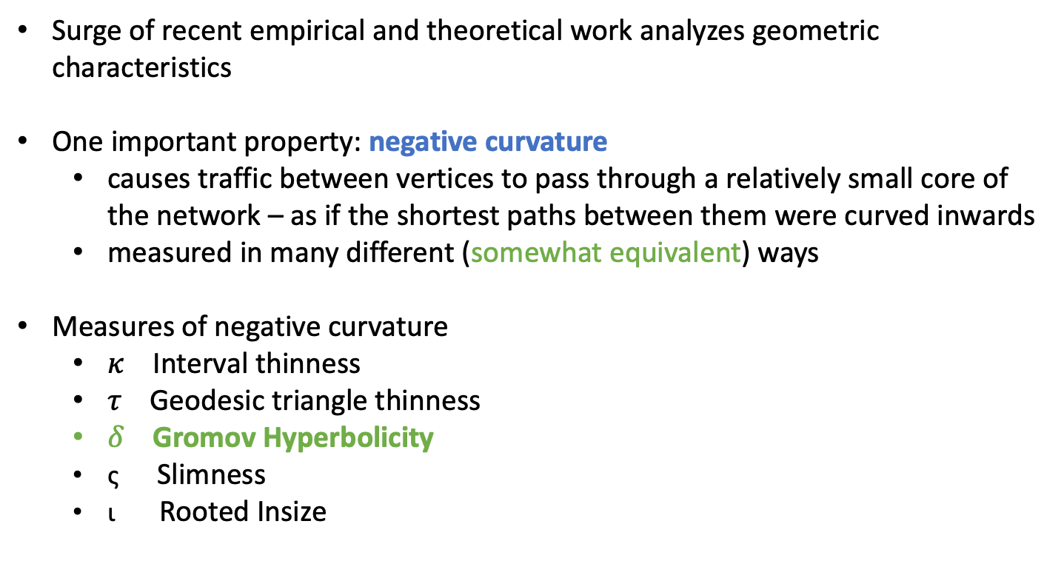
Geometric characteristics of real-world networks
Surge of recent empirical and theoretical work analyzes geometric characteristics
One important property: negative curvature
causes traffic between vertices to pass through a relatively small core of the network – as if the shortest paths between them were curved inwards
measured in many different (somewhat equivalent) ways
Measures of negative curvature
$κ$ Interval thinness
$τ$ Geodesic triangle thinness
$δ$ Gromov Hyperbolicity
ς Slimness
ι Rooted Insize
Notes:
In a metric space with zero curvature, such as the Euclidean space we all know and love, each angle of an equilateral triangle is exactly 60*
Instead, negative curvature in a metric space indicates that an equilateral triangle has angles less than 60*
* There are some metric spaces known to be hyperbolic, such as a Poincare disk (shown here),
* In a metric space or graph with negative curvature, we see this sort of bending property in shortest paths.
It’s been shown that hyperbolic graphs embed with better accuracy into a hyperbolic space than into a Euclidean space of comparable dimension.

Slide 18
δ-Hyperbolicity
u
v
Definition (Gromov’s 4-point condition)
For any four points u,v,w,x, the two larger of the distance sums d(u,v)+d(w,x), d(u,w)+d(v,x), d(u,x)+d(v,w) differ by at most 2δ ≥ 0.
w
x
Notes:
Many recent empirical and theoretical work measures and analyzes geometric characteristics of real-world networks

Slide 19
δ-Hyperbolicity
u
v
Definition (Gromov’s 4-point condition)
For any four points u,v,w,x, the two larger of the distance sums d(u,v)+d(w,x), d(u,w)+d(v,x), d(u,x)+d(v,w) differ by at most 2δ ≥ 0.
w
x
Notes:
Many recent empirical and theoretical work measures and analyzes geometric characteristics of real-world networks

Slide 20
δ-Hyperbolicity
u
v
Definition (Gromov’s 4-point condition)
For any four points u,v,w,x, the two larger of the distance sums d(u,v)+d(w,x), d(u,w)+d(v,x), d(u,x)+d(v,w) differ by at most 2δ ≥ 0.
w
x
Notes:
Many recent empirical and theoretical work measures and analyzes geometric characteristics of real-world networks

Slide 21

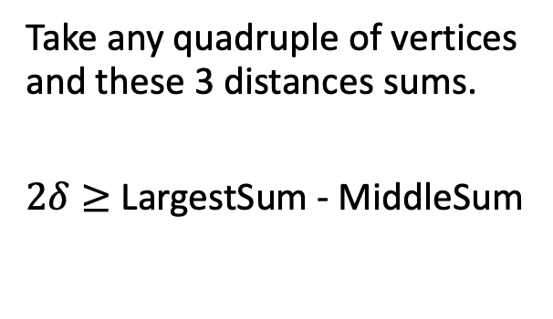
δ-Hyperbolicity
u
v
Definition (Gromov’s 4-point condition)
For any four points u,v,w,x, the two larger of the distance sums d(u,v)+d(w,x), d(u,w)+d(v,x), d(u,x)+d(v,w) differ by at most 2δ ≥ 0.
w
x
Example:
d(u,v) + d(w,x) = 2
d(u,w) + d(v,x) = 2
d(u,x) + d(v,w) = 4
Take any quadruple of vertices and these 3 distances sums.
$2δ≥$ LargestSum - MiddleSum
u
v
w
x
So, $δ=\frac{4−2}{2}=1$
Notes:
Many recent empirical and theoretical work measures and analyzes geometric characteristics of real-world networks

Slide 22
Relation of interval thinness to hyperbolicity
δ-Hyperbolicity measures how close (locally) a metric space is to a tree from a metric point of view; the smaller the value indicates the graph
is metrically closer to a tree (δ=0 in a tree)
has global negative curvature
Lemma (Fellow travelers property): For any graph G, κ(G) ≤ 2δ(G).
u
x
≤ 2δ
y
v
Notes:
Many recent empirical and theoretical work measures and analyzes geometric characteristics of real-world networks

Slide 23
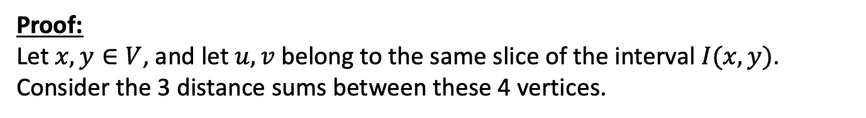



Relation of interval thinness to hyperbolicity
Lemma (Fellow travelers property): For any graph G, κ(G) ≤ 2δ(G).
u
x
≤ 2δ
y
v
Proof:
Let $x,y∈V$, and let $u,v$ belong to the same slice of the interval $I(x,y)$.
Consider the 3 distance sums between these 4 vertices.
$$d\left(x,u\right)+d\left(v,y\right)$$
$$d\left(x,v\right)+d(u,y)$$
$$d\left(x,y\right)+d(u,v)$$
Notes:
Many recent empirical and theoretical work measures and analyzes geometric characteristics of real-world networks

Slide 24

Relation of interval thinness to hyperbolicity
Lemma (Fellow travelers property): For any graph G, κ(G) ≤ 2δ(G).
u
x
≤ 2δ
y
v
Proof:
Let $x,y∈V$, and let $u,v$ belong to the same slice of the interval $I(x,y)$.
Consider the 3 distance sums between these 4 vertices.
$$d\left(x,u\right)+d\left(v,y\right)$$
$$=d(x,y)$$
$$d\left(x,v\right)+d(u,y)$$
$$d\left(x,y\right)+d(u,v)$$
Notes:
Many recent empirical and theoretical work measures and analyzes geometric characteristics of real-world networks

Slide 25

Relation of interval thinness to hyperbolicity
Lemma (Fellow travelers property): For any graph G, κ(G) ≤ 2δ(G).
u
x
≤ 2δ
y
v
Proof:
Let $x,y∈V$, and let $u,v$ belong to the same slice of the interval $I(x,y)$.
Consider the 3 distance sums between these 4 vertices.
$$d\left(x,u\right)+d\left(v,y\right)$$
$$=d(x,y)$$
$$d\left(x,v\right)+d(u,y)$$
$$=d(x,y)$$
$$d\left(x,y\right)+d(u,v)$$
Notes:
Many recent empirical and theoretical work measures and analyzes geometric characteristics of real-world networks

Slide 26
Relation of interval thinness to hyperbolicity
Lemma (Fellow travelers property): For any graph G, κ(G) ≤ 2δ(G).
u
x
≤ 2δ
y
v
Proof:
Let $x,y∈V$, and let $u,v$ belong to the same slice of the interval $I(x,y)$.
Consider the 3 distance sums between these 4 vertices.
$$d\left(x,u\right)+d\left(v,y\right)$$
$$=d(x,y)$$
$$d\left(x,v\right)+d(u,y)$$
$$=d(x,y)$$
$$d\left(x,y\right)+d(u,v)$$
Largest Sum
From definition of hyperbolicity, $2δ≥d\left(x,y\right)+d\left(u,v\right)−d\left(x,y\right)=d(u,v)$.
Notes:
Many recent empirical and theoretical work measures and analyzes geometric characteristics of real-world networks

Slide 27
Relation of interval thinness to hyperbolicity
Lemma (Fellow travelers property): For any graph G, κ(G) ≤ 2δ(G).
u
x
≤ 2δ
y
v
Theorem [1]: For every Helly graph G, κ(G) ≤ 2δ(G) ≤ κ(G)+1.
Open question: What other types of graphs behave in this way?
[1] F. Dragan, H. Guarnera, “Obstructions to a small hyperbolicity in Helly graphs”, Discrete Mathematics, 342(2):326 – 338, 2019.
Notes:
Many recent empirical and theoretical work measures and analyzes geometric characteristics of real-world networks

Slide 28
How can this geometric information be applied?

Slide 29
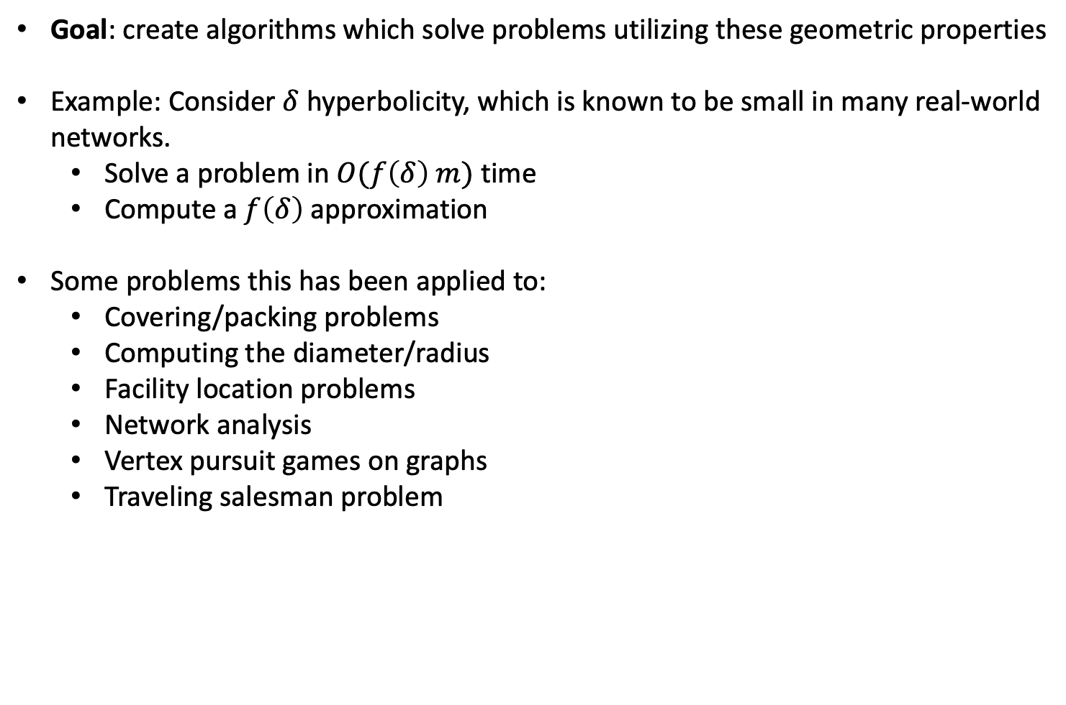
Parameterized complexity/approximation factor
Goal: create algorithms which solve problems utilizing these geometric properties
Example: Consider $δ$ hyperbolicity, which is known to be small in many real-world networks.
Solve a problem in $O(f\left(δ\right) m)$ time
Compute a $f\left(δ\right)$ approximation
Some problems this has been applied to:
Covering/packing problems
Computing the diameter/radius
Facility location problems
Network analysis
Vertex pursuit games on graphs
Traveling salesman problem
Notes:
Many recent empirical and theoretical work measures and analyzes geometric characteristics of real-world networks

Slide 30
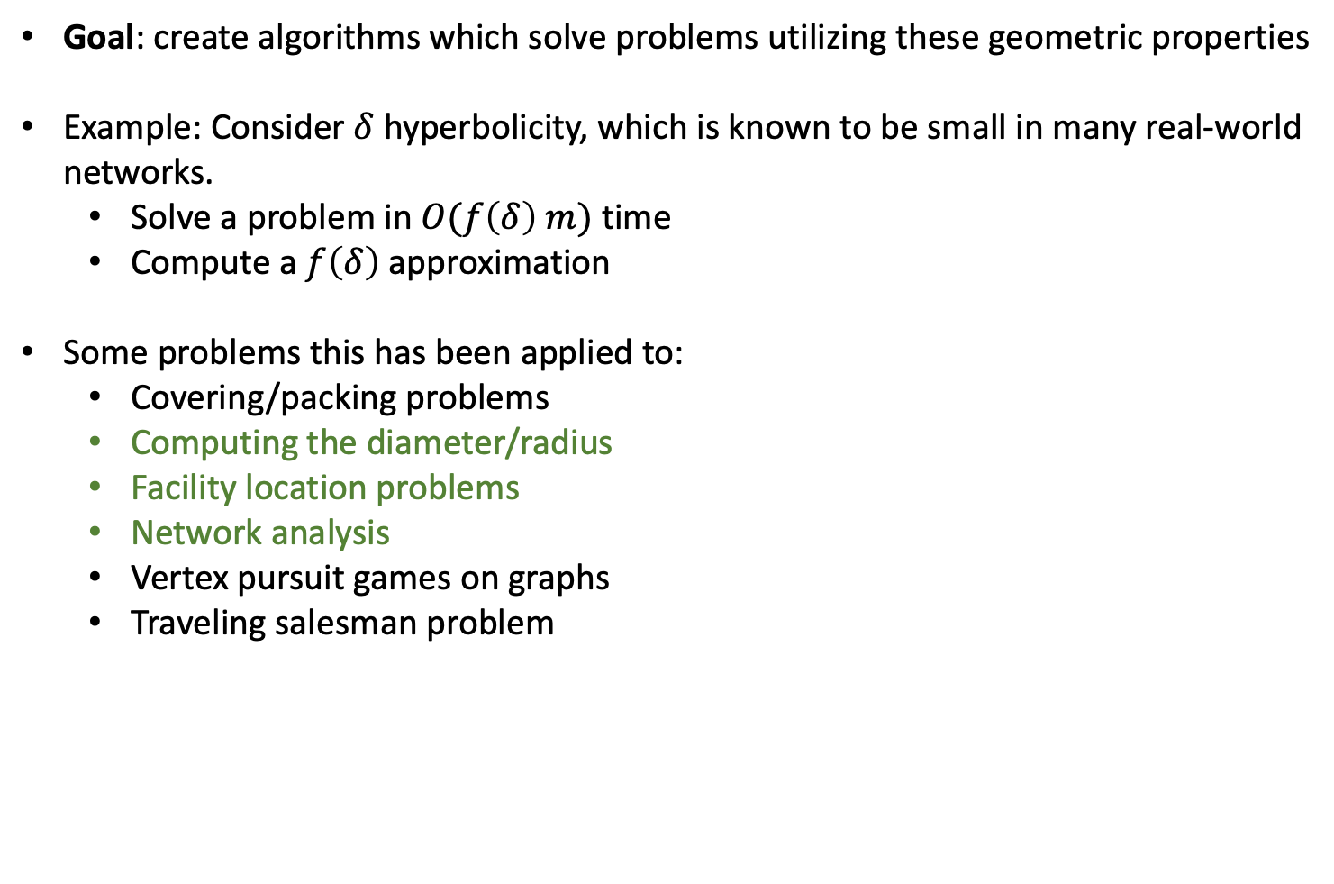
Parameterized complexity/approximation factor
Goal: create algorithms which solve problems utilizing these geometric properties
Example: Consider $δ$ hyperbolicity, which is known to be small in many real-world networks.
Solve a problem in $O(f\left(δ\right) m)$ time
Compute a $f\left(δ\right)$ approximation
Some problems this has been applied to:
Covering/packing problems
Computing the diameter/radius
Facility location problems
Network analysis
Vertex pursuit games on graphs
Traveling salesman problem
F. Dragan and H. Guarnera. Helly-gap of a graph and vertex eccentricities. Theoretical Computer Science, 867:68-84, 2021.
F. Dragan and H. Guarnera. Eccentricity function in distance-hereditary graphs. Theoretical Computer Science, 833: 26-40, 2020.
F. Dragan and H. Guarnera. Eccentricity terrain of 𝛿-hyperbolic graphs. Journal of Computer and System Sciences, 112: 50-56, 2020.
F. Dragan, G. Ducoffe, H. Guarnera. Fast deterministic algorithms for computing all eccentricities in (hyperbolic) Helly graphs, the 17th Algorithms and Data Structures Symposium (WADS'21), 2021.
Mohammed, F. Dragan, H. Guarnera. Fellow Travelers Phenomenon Present in Real-World Networks, Complex Networks & Their Applications, 2022.
Notes:
Many recent empirical and theoretical work measures and analyzes geometric characteristics of real-world networks

Slide 31
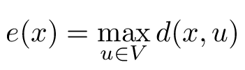
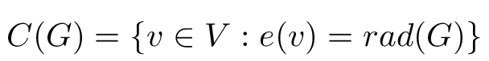
Example: eccentricity function and centers
The eccentricity e(x) of a vertex x is the distance to a furthest u vertex to x
The minimum and maximum eccentricities are called the radius rad(G) and diameter diam(G) of the graph, respectively
3
3
3
The center of a graph C(G) is the set of vertices with minimum eccentricity
4
3
2
3
4
Applications:
Measure the importance of a node (centrality indices)
Facility location problems
Detecting small-world networks (degrees of freedom)
Notes:
Many recent empirical and theoretical work measures and analyzes geometric characteristics of real-world networks

Slide 32
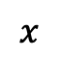
Computing vertex eccentricities straightforwardly.
The eccentricity e(x) of a vertex x is the distance to a furthest u vertex to x
Take a connected graph with n vertices and m edges.
A single Breadth-First Search (BFS) from a vertex x
runs in O(m) time
yields e(x)
Call BFS for each of the n vertices
Total O(nm) runtime
$$x$$
This is prohibitively expensive on many real-world networks, as they are huge!
Notes:
Many recent empirical and theoretical work measures and analyzes geometric characteristics of real-world networks

Slide 33
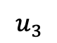

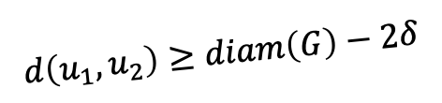
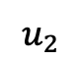
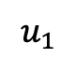
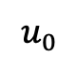
Efficient eccentricity approximation via eccentricity approximating spanning tree
Find a long path in $O(m)$ time
$$u_{0}$$
$$u_{1}$$
$$d\left(u_{1},u_{2}\right)≥diam\left(G\right)−2δ$$
$$u_{3}$$
$$u_{2}$$
Notes:
Many recent empirical and theoretical work measures and analyzes geometric characteristics of real-world networks

Slide 34
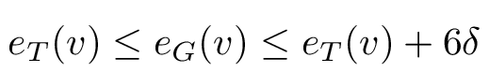
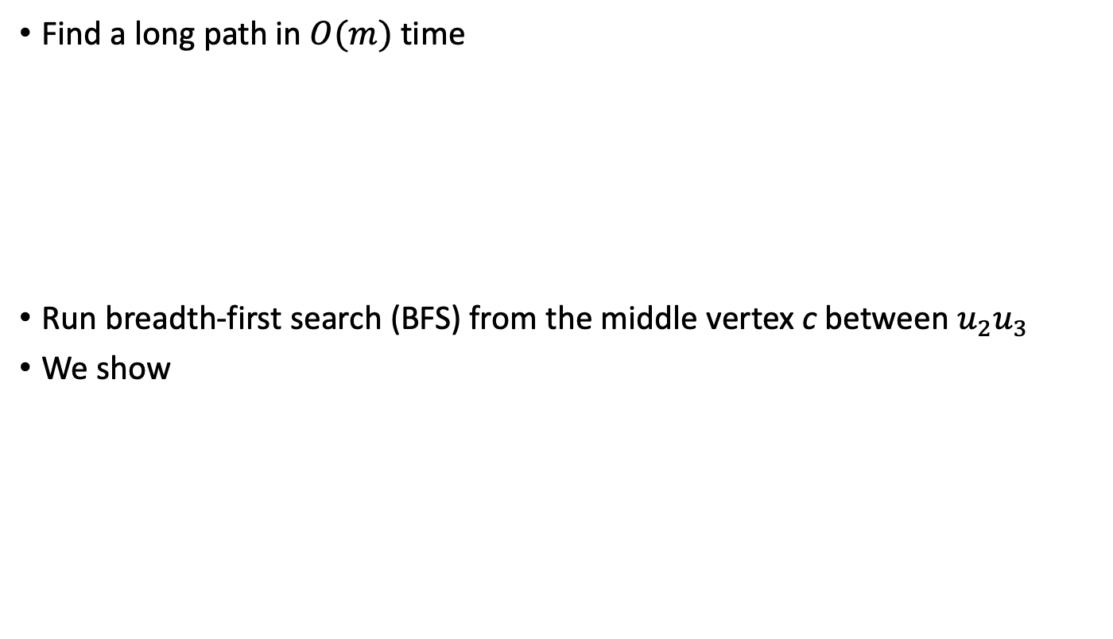
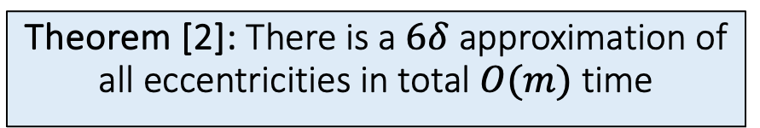
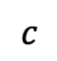
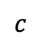
Efficient eccentricity approximation via eccentricity approximating spanning tree
Find a long path in $O(m)$ time
Run breadth-first search (BFS) from the middle vertex c between $u_{2}u_{3}$
We show
$$u_{3}$$
$$u_{2}$$
$$c$$
T
Theorem [2]: There is a $6δ$ approximation of all eccentricities in total $O(m)$ time
$$c$$
[2] F. Dragan and H. Guarnera. Eccentricity terrain of 𝛿-hyperbolic graphs. Journal of Computer and System Sciences, 112: 50-56, 2020.
Notes:
Many recent empirical and theoretical work measures and analyzes geometric characteristics of real-world networks

Slide 35
Conclusion
Many real world networks exhibit the fellow travelers property
Biological networks
Communication networks
Social networks
Software ecosystems
We can take advantage of this nice geometric property to solve problems faster on these networks
Ex: computing vertex eccentricities

Slide 36
Conclusion and future work
Many real world networks exhibit the fellow travelers property
Biological networks
Communication networks
Social networks
Software ecosystems
What else?
We can take advantage of this nice geometric property to solve problems faster on these networks
Ex: computing vertex eccentricities
What else? Ex: vertex pursuit games
How does interval thinness relate to other geometric measures of negative curvature?
What other problems can be solved better with interval thinness, compared to other measures?

Slide 37
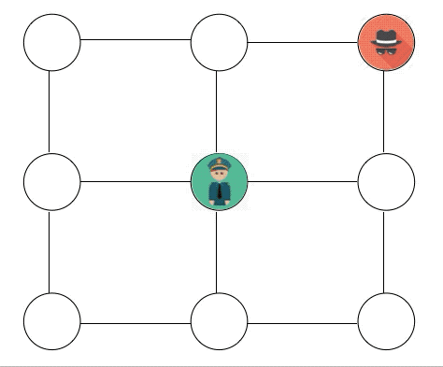
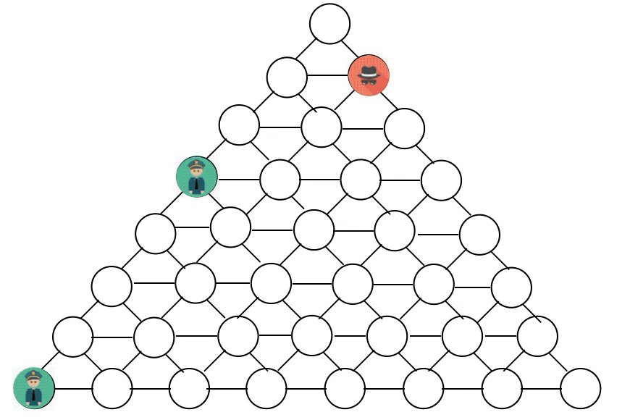
Vertex pursuit games on graphs: cops vs. robbers
cop-win
robber-win

Slide 38
Network analysis: software ecosystems

Slide 39
























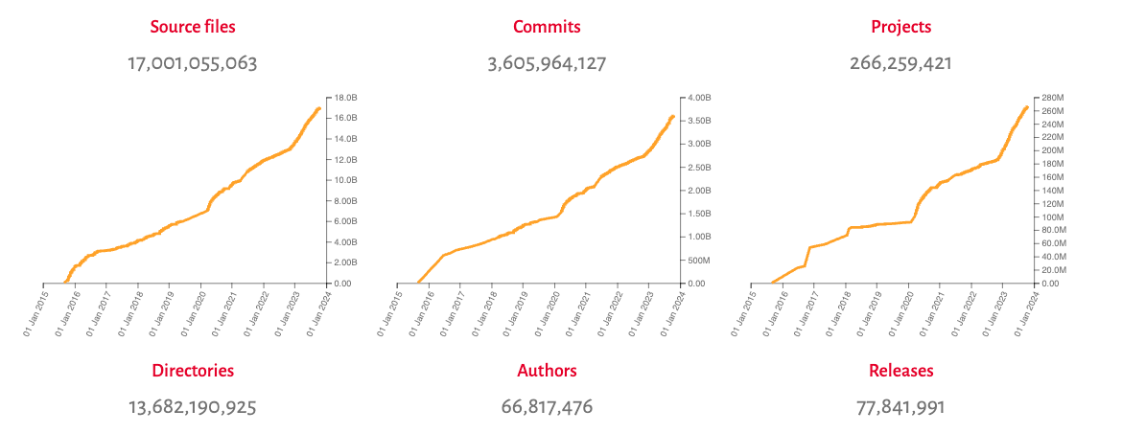
Software Heritage Project

Slide 40
Thank you! Questions?

